Slide 1
Engaging disabled students (Bristol Case Study)
Kate Colechin, Careers Adviser

Slide 2
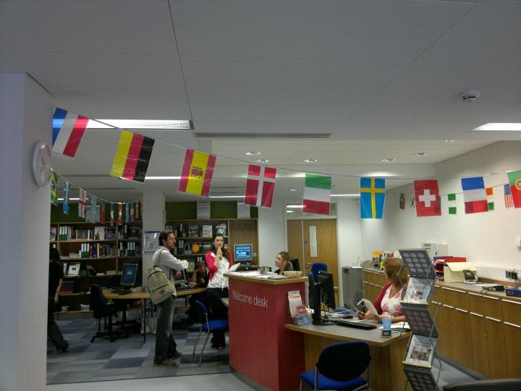

Slide 3
How do we engage?
1-1 Appointments
Workshops
Events & Careers Fairs
Information Resources & Website
“Can you help?”
Disclosure: how & when?
Reasonable adjustments
Work experience
Internships

Slide 5
Disability Services
Guidance on obtaining diagnostic evidence
Disabled Students Allowance (DSA) and other disability funding
Advice on how to access support
Liaising with staff
Signposting

Slide 6
“Can you help?”
Advice on CVs, application forms, interviews
The Equality Act and rights in the workplace
Career Ideas/Pathways

Slide 7
Working Together
Termly meetings between link Advisers
Greater awareness of our services
New Referral Forms
Workshop in the Spring Term

